Slide 1

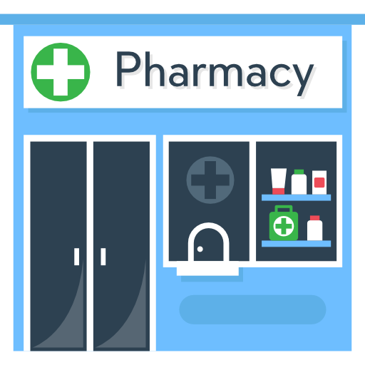
European Pharmacy Analysis: Sales & Product Insights
Prepared by: Anjaly EM

Slide 2

Purpose & Strategic Objectives
The main objectives of this data analysis report are:
To accurately analyze sales and profit across various pharmacies in Europe.
To identify top-performing products and brands generating the highest revenue.
To understand monthly trends and changes in revenue over time.
To support data-driven decision-making for business improvement..

Slide 3
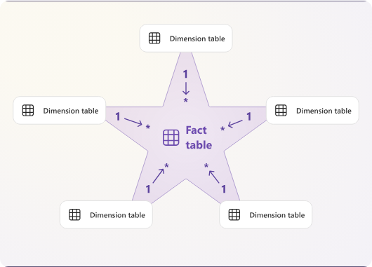

Technical Overview (Data Modeling)
Data Structure: The report is built on a Star Schema model.
Fact Table: Fact Sales (contains core metrics like Cost, Margin, and Units Sold)
Dimension Tables: Dim Product: Includes Brand, Category, and Discontinued status.
Dim Pharmacy: Contains location data such as City and Country.
Dim Date: Provides time-based intelligence (Year, Month, Quarter)
Key Measures:
DAX measures like Total Revenue, Total Profit, Total unit sold and YoY Growth are used to calculate accurate business performance metrics.

Slide 4


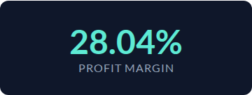

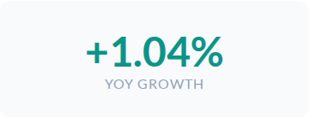
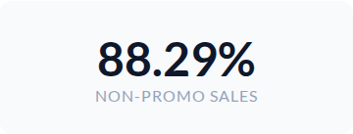
Executive Performance Indicators
Overall, the business shows strong financial performance with a 28.04% profit margin and steady +1.04% YoY growth. Also, 88.29% of sales came without promotions, showing strong customer demand and brand value.

Slide 5



Sales Trends & Seasonality
Monthly Revenue Distribution (2024 - 2025)
* Notable revenue peaks observed in January and July across the UK and Germany markets.

Slide 6


Market & Product Leadership
Top Performing Products
High-Impact Cities
PainLess
Milan: Top revenue generator in Southern Europe.
DigestEase
Hamburg: Leading logistical hub for Germany.
Top Products: ‘Painless’ (93K) and ‘DigestEase’ (64K) are the highest revenue-generating products.
Liege: Strongest growth rate in the Benelux region.

Slide 7
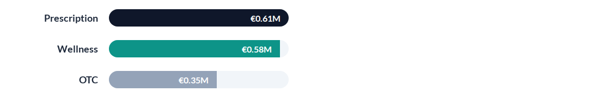

Profit Analysis by Category
Strategy Note
Prescription and Wellness segments drive over 50% of total profitability.

Slide 8
Operations & Impact Analysis
Top-performing pharmacy locations and their specific achievements:
Munich HealthPoint #095: It is the top earner (Top Revenue).
London Central Care: It is leading the fastest growth (Growth Lead).
Paris Wellness Hub: It has the highest profit margins (Margin Lead).
Pharmacy Location | Status
Munich HealthPoint #095 | Top Revenue
London Central Care | Growth Lead
Paris Wellness Hub | Margin Lead

Slide 9
Strategic Recommendations
High-Margin Focus: Prioritize marketing spend on "Prescription" and "Wellness" sectors to stabilize long-term profitability.
Regional Supply Chain: Expand warehouse capacity in Milan and Munich to support high-performance retail clusters.
Promotion Strategy: Re-evaluate promotional spend. 88% of current sales are organic; focus promotions on low-performing OTC items.
Transition Management: Develop a 12-month phase-out plan for the 8% revenue tied to discontinued products.

Slide 10
Conclusion
This Power BI report shows that the European pharmacy business is operating with a 28.04% profit margin.
Branded medicines and specific cities contribute most to revenue.
Using these insights, adjusting marketing strategies can further improve business growth.
Thank you for your attention.

